Slide 1
Domain Driven Design
Maciej Zelwak
Notes:
Glossary:
AGGREGATE
A cluster of associated objects that are treated as a unit for the purpose of data changes.
External references are restricted to one member of the AGGREGATE, designated as the root.
A set of consistency rules applies within the AGGREGATE'S boundaries.
analysis pattern
A group of concepts that represents a common construction in business modeling. It may be
relevant to only one domain or may span many domains (Fowler 1997, p. 8).
ASSERTION
A statement of the correct state of a program at some point, independent of how it does it.
Typically, an ASSERTION specifies the result of an operation or an invariant of a design
element.
BOUNDED CONTEXT
The delimited applicability of a particular model. BOUNDING CONTEXTS gives team members a
clear and shared understanding of what has to be consistent and what can develop
independently.
client
A program element that is calling the element under design, using its capabilities.
cohesion
Logical agreement and dependence.
command (a.k.a. modifier)
An operation that effects some change to the system (for example, setting a variable). An
operation that intentionally creates a side effect.
CONCEPTUAL CONTOUR
An underlying consistency of the domain itself, which, if reflected in a model, can help the
design accommodate change more naturally.
context
The setting in which a word or statement appears that determines its meaning.
See also [BOUNDED CONTEXT]
CONTEXT MAP
A representation of the BOUNDED CONTEXTS involved in a project and the actual relationships
between them and their models.
CORE DOMAIN
The distinctive part of the model, central to the user's goals, that differentiates the
application and makes it valuable.
declarative design
A form of programming in which a precise description of properties actually controls the
software. An executable specification.
deep model
An incisive expression of the primary concerns of the domain experts and their most
relevant knowledge. A deep model sloughs off superficial aspects of the domain and naive
interpretations.
design pattern
A description of communicating objects and classes that are customized to solve a general
design problem in a particular context. (Gamma et al. 1995, p. 3)
distillation
A process of separating the components of a mixture to extract the essence in a form that
makes it more valuable and useful. In software design, the abstraction of key aspects in a
model, or the partitioning of a larger system to bring the CORE DOMAIN to the fore.
domain
A sphere of knowledge, influence, or activity.
domain expert
A member of a software project whose field is the domain of the application, rather than
software development. Not just any user of the software, the domain expert has deep
knowledge of the subject.
domain layer
That portion of the design and implementation responsible for domain logic within a LAYERED
ARCHITECTURE. The domain layer is where the software expression of the domain model lives.
ENTITY
An object fundamentally defined not by its attributes, but by a thread of continuity and
identity.
FACTORY
A mechanism for encapsulating complex creation logic and abstracting the type of a created
object for the sake of a client.
function
An operation that computes and returns a result without observable side effects.
immutable
The property of never changing observable state after creation.
implicit concept
A concept that is necessary to understand the meaning of a model or design but is never
mentioned.
INTENTION-REVEALING INTERFACE
A design in which the names of classes, methods, and other elements convey both the
original developer's purpose in creating them and their value to a client developer.
invariant
An ASSERTION about some design element that must be true at all times, except during
specifically transient situations such as the middle of the execution of a method, or the
middle of an uncommitted database transaction.
iteration
A process in which a program is repeatedly improved in small steps. Also, one of those
steps.
large-scale structure
A set of high-level concepts, rules, or both that establishes a pattern of design for an entire
system. A language that allows the system to be discussed and understood in broad strokes.
LAYERED ARCHITECTURE
A technique for separating the concerns of a software system, isolating a domain layer,
among other things.
life cycle
A sequence of states an object can take on between creation and deletion, typically with
constraints to ensure integrity when changing from one state to another. May include
migration of an ENTITY between systems and different BOUNDED CONTEXTS.
model
A system of abstractions that describes selected aspects of a domain and can be used to
solve problems related to that domain.
MODEL-DRIVEN DESIGN
A design in which some subset of software elements corresponds closely to elements of a
model. Also, a process of codeveloping a model and an implementation that stay aligned
with each other.
modeling paradigm
A particular style of carving out concepts in a domain, combined with tools to create
software analogs of those concepts (for example, object-oriented programming and logic
programming).
REPOSITORY
A mechanism for encapsulating storage, retrieval, and search behavior which emulates a
collection of objects.
responsibility
An obligation to perform a task or know information (Wirfs-Brock et al. 2003, p. 3).
SERVICE
An operation offered as an interface that stands alone in the model, with no encapsulated
state.
side effect
Any observable change of state resulting from an operation, whether intentional or not, even
a deliberate update.
SIDE-EFFECT-FREE FUNCTION
See [function]
STANDALONE CLASS
A class that can be understood and tested without reference to any others, except system
primitives and basic libraries.
stateless
The property of a design element that allows a client to use any of its operations without
regard to the element's history. A stateless element may use information that is accessible
globally and may even change that global information (that is, it may have side effects) but
holds no private state that affects its behavior.
strategic design
Modeling and design decisions that apply to large parts of the system. Such decisions affect
the entire project and have to be decided at team level.
supple design
A design that puts the power inherent in a deep model into the hands of a client developer
to make clear, flexible expressions that give expected results robustly. Equally important, it
leverages that same deep model to make the design itself easy for the implementer to mold
and reshape to accommodate new insight.
UBIQUITOUS LANGUAGE
A language structured around the domain model and used by all team members to connect
all the activities of the team with the software.
unification
The internal consistency of a model such that each term is unam-biguous and no rules
contradict.
VALUE OBJECT
An object that describes some characteristic or attribute but carries no concept of identity.
WHOLE VALUE
An object that models a single, complete concept.
Core definitions
Domain: A sphere of knowledge (ontology), influence, or activity. The subject area to which the user applies a program is the domain of the software.
Model: A system of abstractions that describes selected aspects of a domain and can be used to solve problems related to that domain.
Ubiquitous Language: A language structured around the domain model and used by all team members to connect all the activities of the team with the software.
Context: The setting in which a word or statement appears that determines its meaning.
Prerequisites for the successful application of DDD
Your domain is not trivial
The project team has experience and interest in Object Oriented Programming/Design
You have access to domain experts
You have an iterative process
Building blocks
Strategic patterns
Domain, and Subdomains: As mentioned above, a Domain is a sphere of knowledge. A Domain can be split into Subdomains if it is too large. The Domain is usually known as the problem space.
Bounded Context: A Bounded context should be aligned with a Domain or a Subdomain. There is one Ubiquitous Language applied within a Bounded Context. A Bounded Context is usually the solution space, where we design our software or business solution.
Context Map: A Context Map displays the alignment of Domains, Subdomains and their Bounded Contexts. A Context Map also shows dependencies between Bounded Contexts. Such dependencies can be upstream or downstream. Dependencies show where integration patterns should or must be applied.
Tactical patterns
Entity: An object that is not defined by its attributes, but rather by a thread of continuity and its identity. Example: Most airlines distinguish each seat uniquely on every flight. Each seat is an entity in this context. However, Southwest Airlines (or EasyJet/RyanAir for Europeans) does not distinguish between every seat; all seats are the same. In this context, a seat is actually a value object. Value Object: An object that contains attributes but has no conceptual identity. They should be treated as immutable. Example: When people exchange dollar bills, they generally do not distinguish between each unique bill; they only are concerned about the face value of the dollar bill. In this context, dollar bills are value objects. However, the Federal Reserve may be concerned about each unique bill; in this context each bill would be an entity. Aggregate: A collection of objects that are bound together by a root entity, otherwise known as an aggregate root. The aggregate root guarantees the consistency of changes being made within the aggregate by forbidding external objects from holding references to its members. Aggregates can also be seen as a kind of bounded context, giving the root entity and the whole object graph a context in which they are used. Example: When you drive a car, you do not have to worry about moving the wheels forward, making the engine combust with spark and fuel, etc.; you are simply driving the car. In this context, the car is an aggregate of several other objects and serves as the aggregate root to all of the other systems. A steering wheel can be rotated, this is it's context within the car aggregate. It can also be produced or recycled. This usually happens not within the driving car context, so this would be another aggregate, probably referencing the car as well.
Domain Events: Domain events can be used to model distributed systems. The model will become more complex, but it can by more scalable. Domain Events are often used in an Event Driven Architecture
Service: When an operation does not conceptually belong to any object. Following the natural contours of the problem, you can implement these operations in services. Repository: Repositories save and retrieve Entities or Aggregates to or from the underlying storage mechanism. Repositories are part of the domain model, so they should be database vendor independent. Repositories can use DAO's(Data Access Objects) for retrieving data and to encapsulate database specific logic from the domain. Note: Hibernate is also a Data Access Object! Wrapping Hibernate inside a DAO can be an overkill. Repositories can use an Aggregate Oriented Database.
Modules, also known as Packages: Components with high cohesion should be packaged together. Modules are defined by business dependencies, not by the technical architecture.
Example: The Bill Aggregate and the Bill Repository should be put into the same module, as they are very tightly coupled. Factory: methods for creating domain objects should delegate to a specialized Factory object such that alternative implementations may be easily interchanged.

Slide 2
Agenda
1. Layered/Tiered architeture
2. Structuring domain logic
3. DDD main principles
- Layers
- Services
- Entities and Value Objects
- Aggregates
- Bounded Context
- Q Language
- Repositories
4. DDD Life cycle
5. Unit testing and refactoring

Slide 3
Structuring domain logic
Procedural
Domain driven design
1. Procedural (Transaction Script)
- database driven
- logic concentrated in a set of
application services
- entities encapsulate only data without
behaviour
2. Domain model-based (Domain Model)
- logic concentrated in a set of business objects
- entities corespond to real-world objects
- Data Mappers are used to keep data independet
between domain model and database
3. Table-based record set (Table Module)
Presentation
Presentation
Business Tier
Business Tier
Transaction script
Transaction script
Data Object
Data Object
Data
Data Access Tier
Data Access Tier
- behaviour
- state
Notes:
We can discuss three types of requirements that any application software has to fulfill:
Requirements originating from users, which determine system’s purpose and how the system is used. These requirements are usually captured is Use Cases.
Non-functional requirements that capture quality attributes of the system: reliability, performance, seurity and many others.
Domain requirements, which capture essential domain concepts, their relationships and important rules. Business rules for instance control the way a business operations.
During my presentations I will interchengeably use terms: business rules, domain logic or business logic.
Historically, there have been several approaches to organizing and implementing business logic in applications. We can identify three patterns of organizing domain logic in enterprise applications:
Table-based record set (Table Module)
Procedural (Transaction Script)
Domain model-based (Domain Model)
1 & 2 are largely database-driven in a sense that the relational model determines the structuring of domain objects and their releationships.
All logic concentrated in a set of heavyweight application services operating on database table-like objects, instead of actual business entities where they naturally belong.
Each method in service handles a single request from the presentation layer.
Domain objects do not encapsulate any business logic. They are simple data containers with properties, which is in a fundamental conflict with OO paradigm of encapsulating both data and behaviour. It is called as anemic domain model.
3 pattern, on the other hand, stresses the importance of decompling the object model from the database model. According to this pattern, encapsulating all domain logic in a set of interconnected business objects is a way to manage complexity inherent in most business. Essentially, the business logic is modeled as operations on classes and spread among a collection of domain objects (see picture).
Domain model is intended to be purely conceptual: classes in this model correspond to real-world objects. To ensure that data can be transparently passed between the two potentially diverging models very often Data Mapper is used (ex. Nhibernate, Entity Framework).

Slide 4
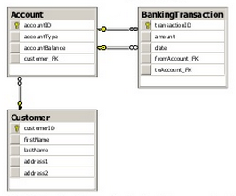
Structuring domain logic
Procedural database–driven design example
Web Tier
ASPX Controller
Business Tier
MoneyTransferService
TransferMoney(int from, int to, int amount)
Data Tier
Account
AccountID
AccountType
Balance
BankingTransaction
Customer
TransactionID
Amount
Date
CustomerID
FirstName
Address1
Address2
Maps
one – to – one
Notes:
Advantages:
Does not require significant modeling skills
It is easy to add new functionalities by implementing a new transaction script
Risks and disadvantages of this patterns:
Entities could be split into several entity-releated tables in the database due to normalization requirements
Posible redundancy in code
Does not scale well to complex business domain (problems with maintability)

Slide 5
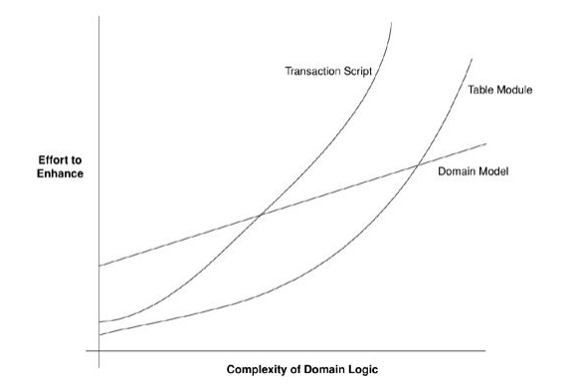
Structuring domain logic
Table vs Procedural vs Domain
When procedural style is better:
Very little domain logic
Mostly data entry and retrieval
Short deadlines
Prototypes
Low level of modeling skills
When domain model style is better:
Lots and lots of compliceted business logic
Long-lived project lifetime
Ambitious goals
High level of modeling skillks
Where is table module style?
Notes:
There are a number of benefits to having a domain model at the core of the application design.
- Firstly, because domain model is decoupled form the relational model, such design better reflects the reality of business.
- Stakeholders and developers are able to operate in terms of real business concepts.
These concepts rarely change and are quite stable. Therefore it becomes possible to reuse the model in a new context (for example in new applications)
When procedural style seems to be better aproach:
Essentially, procedural style is better for simple, small applications and applications that don’t require high scalability and maintability
Can be better choice for applications storing and retrieving data (dropbox)
Domain driven desing applications usually require more coding in first feaze of development, therefore are not recommended for prototyping and projects with very short deadline
Finally, we need to have in the team at least one person with high level of modeling skills for domain modeling, otherwise you will have big mess.

Slide 6
Application design
User Interface
- Presenting information to the user - Interpreting user commands
- Coordinates the application activity
Application
- Can hold the state of an application
task’s progress
- Holds the state of business objects
- Encapsulates business logic
Domain
- Supporting role for other layers
- Implements persistance for
business objects
Infrastructure
Notes:
A typical enterprise application architecture consists of the following four conceptual layers:
User Interface (Presentation Layer): Responsible for presenting information to the user and interpreting user commands.
Application Layer: This layer coordinates the application activity. It doesn't contain any business logic. It does not hold the state of business objects, but it can hold the state of an application task's progress.
Domain Layer: This layer contains information about the business domain. The state of business objects is held here. Persistence of the business objects and possibly their state is delegated to the infrastructure layer.
Infrastructure Layer: This layer acts as a supporting library for all the other layers. It provides communication between layers, implements persistence for business objects, contains supporting libraries for the user interface layer, etc.
From a design stand-point, the domain layer should have a well defined boundary to avoid the corruption of the layer from non-core domain layer concerns such as vendor-specific translations, data filtering, transformations, etc. Domain elements should be designed to hold the domain state and behavior correctly. Different domain elements are structured differently based on state and behavior.
Table 2 below shows the domain elements and what they contain.
Table 2. Domain elements with state and behavior
Domain ElementState/BehaviorEntity, Value Object, AggregateState and BehaviorData Transfer ObjectState onlyService, RepositoryBehavior onlyEntities, Value Objects, and Aggregates which contain both state (data) and behavior (operations), should have clearly defined state and behavior. At the same time, this behavior should not extend beyond the limits of the object's boundaries. Entities should do most of the work in the use case acting on their local state. But they shouldn't know about too many unrelated concepts.
Good design practice is to only include the getters/setters for the attributes that are required to encapsulate the state of domain objects. When designing the domain objects, only provide setter methods for those fields that can change. Also, the public constructors should contain only the required fields instead of a constructor with all the fields in the domain class.
In most of the use cases, we don't really have to be able to change the state of an object directly. So, instead of changing the internal state, create a new object with the changed state and return the new object. This is sufficient in these use cases and it also reduces design complexity.
Aggregate classes hide the usage of collaborating classes from callers. They can be used for encapsulating complex, intrusive, and state-dependent requirements in the domain classes.
Within each Bounded Context there are Aggregates and Value Objects. Aggregates are object hierarchies, but only the root of the hierarchy is accessible from outside of the Aggregate. Aggregates take care of business invariants. Every access to the object tree must go thru the Aggregate and not over one element within. This greatly increases encapsulation.
Aggregates and Entites are things with an unique id in our model. Value Objects are not things, they are values or measures, like a UserId. Value Objects are designed to be immutable, they cannot change their state. Every state changing method returns a new instance of the value Object. This helps us to eliminate unwanted side effects.
Design Patterns that Support DDD
There are several design patterns that help in domain driven design and development. Following is a list of these design patterns:
Domain Object (DO)
Data Transfer Object (DTO)
DTO Assembler
Repository: The Repository contains domain-centric methods and uses the DAO to interact with the database.
Generic DAO's
Temporal Patterns: These patterns add time dimension to rich domain models. Bitemporal framework, which is based on Martin Fowler's Temporal Patterns, provides a design approach to dealing with bitemporal issues in the domain models. The core domain objects and their bitemporal properties can be persisted using an ORM product such as Hibernate.
Other design patterns that are used in DDD include Strategy, Facade, and Factory. Jimmy Nilsson discussed Factory as one of the domain patterns in his book.
DDD Anti-Patterns
On the flip side of the best practices and design patterns, there are some DDD smells that architects and developers should watch out for when implementing the domain model. As a result of these anti-patterns, domain layer becomes the least important part in application architecture and facade classes assume a more important role in the model. Following are some of these anti-patterns:
Anemic domain objects
Repetitive DAO's
Fat Service Layer: This is where service classes will end up having all the business logic.
Feature Envy: This is one of the classic smells mentioned in Martin Fowler's book on Refactoring where the methods in a class are far too interested in data belonging to other classes.
Data Access Objects
DAO's and Repositories are also important in domain driven design. DAO is the contract between relational database and the application. It encapsulates the details of database CRUD operations from the web application. On the other hand, a Repository is a separate abstraction that interacts with the DAOs and provides "business interfaces" to the domain model.
Repositories speak the Ubiquitous Language of the domain, work with all necessary DAOs and provide data access services to the domain model in a language the domain understands.
DAO methods are fine-grained and closer to the database while the Repository methods are more coarse-grained and closer to the domain. Also one Repository class may have multiple DAO's injected. Repositories and DAO's keep the domain model decoupled from dealing with the data access and persistence details.
The domain objects should depend only on Repository interfaces. This is the reason why injecting the Repository instead of a DAO results in a much cleaner domain model. DAO classes should never be called directly from the client (Services and other consumer classes). The clients should always call the domain objects which in turn should call the DAO's for persisting the data to the data store.
Managing the dependencies between domain objects (for example, the dependency between an Entity and its Repository) is a classic problem that developers often run into. The usual design solution to this problem is to have the Service or Facade class call a Repository directly and when invoked the Repository would return the Entity object to the client. This design eventually leads to the afore-mentioned Anemic Domain Model where facade classes start accumulating more business logic and domain objects become mere data carriers. A good design is to inject Repositories and Services into domain objects using DI & AOP techniques.
Sample application follows these design principles in implementing the loan processing domain model.
Persistence
Persistence is an infrastructural aspect from which the domain layer should be decoupled. JPA provides this abstraction by hiding the details of the persistence implementation from the classes. It is annotation driven so no XML mapping files are required. But at the same time, the table and column names are embedded in the code which may not be a flexible solution in some cases.
With grid computing products such as Oracle Coherence, WebSphere Object Grid, andGigaSpaces that offer data grid solutions, the developers don't even need to think about a RDBMS when they model and design the business domain. The database layer is abstracted from domain layer in the form of an in-memory Object/Data Grid.
Caching
When we talk about the state (data) of the domain layer, we have to talk about the aspect of caching. Frequently accessed domain data (such as products and rates in a mortgage loan processing application) are good candidates for caching. Caching speeds up the performance and reduces the load on the database server. Service layer is ideal for caching the domain state. ORM frameworks like TopLink and Hibernate also provide data caching.
Loan processing sample application uses JBossCache framework to cache product and rate details to minimize the database calls and improve application performance.
Transaction Management
Transaction management is important to keep the data integrity and to commit or rollback the UOW as a whole. There has always been a debate about where the transactions should be managed in the application architecture layers. There are also the cross-entity transactions (that span multiple domain objects in the same UOW) that affect the design decision of where the transactions should be managed.
Some developers prefer managing the transactions in the DAO classes which is a poor design. This results in too fine-grained transaction control which doesn't give the flexibility of managing the use cases where the transactions span multiple domain objects. Service classes should handle transactions; this way even if the transaction spans multiple domain objects, the service class can manage the transaction since in most of the use cases the Service class handles the control flow.
FundingServiceImpl class in the sample application manages transactions for the funding request and executes multiple database operations by calling the Repositories and commits or rolls back all database changes in a single transactions.
Data Transfer Objects
DTO's are also an important part of the design in an SOA environment where the Domain object model structurally is not compatible with the messages that are received and sent from a business service. The messages are typically defined and maintained in as XML Schema Definition documents (XSD's) and it's a common practice to write (or code generate) DTO objects from the XSD's and use them for data (message) transfer purposes between domain and SOA service layers. Mapping the data from one or more domain objects to a DTO will become a necessary evil in distributed applications where sending the domain objects across the wire may not be practical from a performance and a security stand-point.
From a DDD perspective, DTO's also help maintain the separation between Service and UI layers where DO's are used in the domain and service layers and DTO's are used in the presentation layer.
Dozer framework is used for the assembly of one or more domain objects into a DTO object. It is bi-directional which saves a lot of extra code and time when converting domain objects into DTO's and vice-versa. The 2-way mapping between DO and DTO objects helps eliminate the separate DO -> DTO and DTO -> DO translation logic. The framework also correctly handles the type and array conversion.
The sample application uses Dozer mapping files (XML) to split the FundingRequestDTO object into Loan, Borrower, and FundingRequest Entity objects when the request comes in for fund processing. The mapping also takes care of the aggregation of the funding response data from the Entities into a single DTO object on the way back to the client.
Gathering data from more than one domain:
Proxy component in application domain – simpe cases (delete object if not used by other objects in other domains)
Events for asyc requests
???

Slide 7
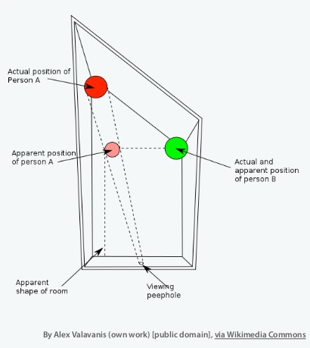
What is model and domain?
Model is „a rigorously organized and selective abstraction of that knowledge.”
Domain is „sphere of knowledge” or „problem space.”
Notes:
Ames Room
Used in The Lord Of The Rings: The Fellowship of the Ring to make the hobbits apear the correct size in relation to Gandalf. We are always using mental models to understand the world around us – we do not perceive an object reality.
World Map
This eighteenth-century Chinese map represents the whole world. In the center and taking up most of the space is China, surrounded by perfunctory representations of other countries. This was a model of the world appropriate to that society, which had intentionally turned inward. The worldview that the map represents must not have been helpful in dealing with foreigners. Certainly it would not serve modern China at all. Maps are models, and every model represents some aspect of reality or an idea that is of interest. A model is a simplification. It is an interpretation of reality that abstracts the aspects relevant to solving the problem at hand and ignores extraneous detail.
Software applications
Every software program relates to some activity or interest of its user. That subject area to which the user applies the program is the domain of the software. Some domains involve the physical world: The domain of an airline-booking program involves real people getting on real aircraft. Some domains are immaterial: The domain of an accounting program is money and finance. Software domains usually have little to do with computers, though there are exceptions: The domain of a source-code control system is software development itself. To create software that is valuably involved in users' activities, a development team must bring to bear a body of knowledge related to those activities. The breadth of knowledge required can be daunting. The volume and complexity of information can be overwhelming.
Models are tools for grappling with this overload. A model is a selectively simplified and consciously structured form of knowledge. An appropriate model makes sense of information and focuses it on a problem.
A domain model is not a particular diagram; it is the idea that the diagram is intended to convey. It is not just the knowledge in a domain expert's head; it is a rigorously organized and selective abstraction of that knowledge. A diagram can represent and communicate a model, as can carefully written code, as can an English sentence.
Domain modeling is not a matter of making as "realistic" a model as possible. Even in a domain of tangible real-world things, our model is an artificial creation. Nor is it just the construction of a software mechanism that gives the necessary results. It is more like moviemaking, loosely representing reality to a particular purpose. Even a documentary film does not show unedited real life. Just as a moviemaker selects aspects of experience and presents them in an idiosyncratic way to tell a story or make a point, a domain modeler chooses a particular model for its utility.

Slide 8
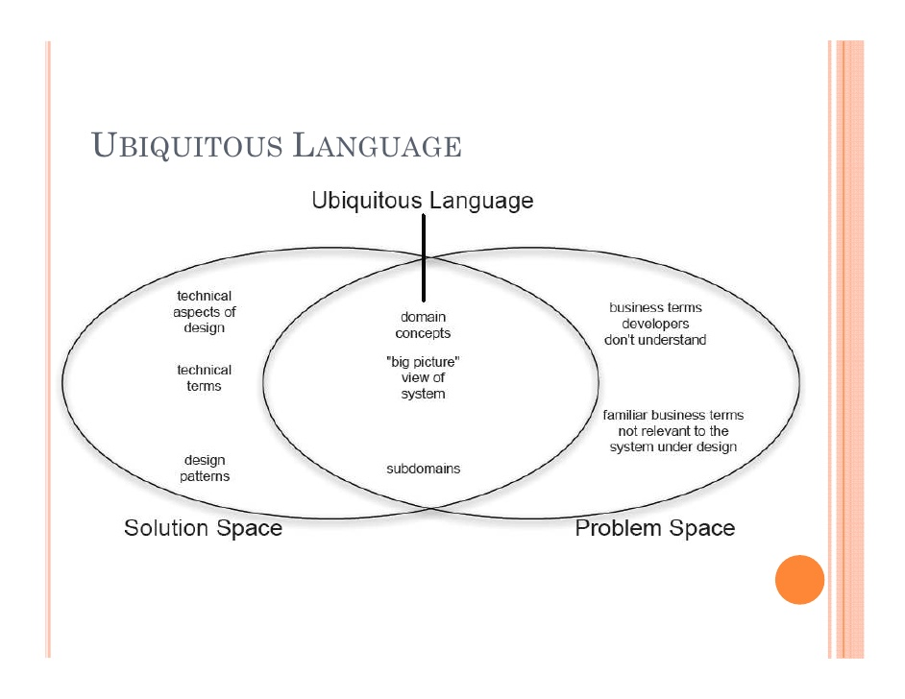
Ubiquious language
Notes:
Ingredients of Effective Modeling
Certain things we did led to the success I just described.
Binding the model and the implementation. That crude prototype forged the essential link
early, and it was maintained through all subsequent iterations.
1.
Cultivating a language based on the model. At first, the engineers had to explain elementary
PCB issues to me, and I had to explain what a class diagram meant. But as the project
proceeded, any of us could take terms straight out of the model, organize them into
sentences consistent with the structure of the model, and be un-ambiguously understood
without translation.
2.
Developing a knowledge-rich model. The objects had behavior and enforced rules. The model
wasn't just a data schema; it was integral to solving a complex problem. It captured
knowledge of various kinds.
3.
Distilling the model. Important concepts were added to the model as it became more
complete, but equally important, concepts were dropped when they didn't prove useful or
central. When an unneeded concept was tied to one that was needed, a new model was
found that distinguished the essential concept so that the other could be dropped.
4.
Brainstorming and experimenting. The language, combined with sketches and a
brainstorming attitude, turned our discussions into laboratories of the model, in which
hundreds of experimental variations could be exercised, tried, and judged. As the team went
through scenarios, the spoken expressions themselves provided a quick viability test of a
proposed model, as the ear could quickly detect either the clarity and ease or the
awkwardness of expression.
But what is a Domain? A Domain is a “sphere of knowledge”, for instance the business the company runs. A Domain is also called a “problem space”, so the problem for which we have to design a solution.

Slide 9
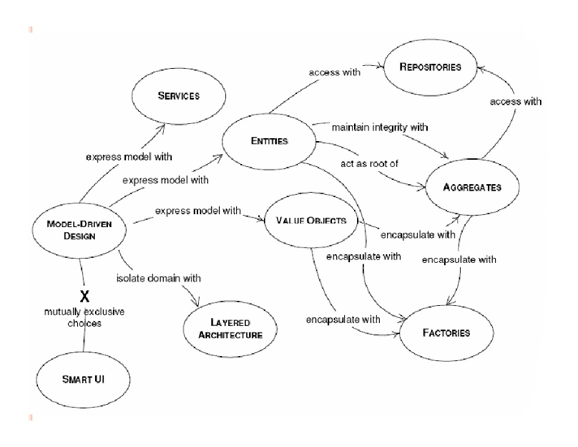
Ingredients of Effective Modeling
Notes:
http://www.mirkosertic.de/doku.php/architecturedesign/dddexample
Financial analysts crunch numbers. Effective domain modelers are knowledge crunchers. They take a torrent of information and probe
for the relevant trickle. They try one organizing idea after another, searching for the simple view
that makes sense of the mass.
Rich domain model
The domain model should focus on a specific business operational domain. It should align with the business model, strategies and business processes.
It should be isolated from other domains in the business as well as other layers in the application architecture.
It should be reusable to avoid any duplicate models and implementations of the same core business domain elements.
The model should be designed loosely coupled with other layers in the application, meaning no dependencies on the layers on either side of domain layer (i.e. database and facade layers).
It should be an abstract and cleanly separated layer enabling easier maintenance, testing, and versioning. The domain classes should be unit testable outside the container (and from inside the IDE).
It should be designed using a POJO programming model without any technology or framework dependencies (I always tell the project teams I work with in my company, that the technology we use for software development is Java).
The domain model should be independent of persistence implementation details (although the technology does place some constraints on the model).
It should have minimum dependencies on any infrastructure frameworks because it will outlive these frameworks and we don't want any tight coupling on any external framework.
DDD is not a technology or methodology. DDD provides a structure of practices and terminology for making design deisions that focus and accelerate software projects complicated domains.
A domain modeling project typically includes the following steps:
Model and document business processes first.
Select a candidate business process and work with the business domain experts to document it using the Ubiquitous Language.
Identify all the services that are required for the candidate business process. These services can be atomic (single step) or orchestrated (multi-step with or without work-flow) in nature. They can also be business (e.g. Underwriting or Funding) or infrastructure (e.g. E-mail or Job Scheduling).
Identify and document the state and behavior of the objects used by services identified in the previous step.
When Modeling the Domain, Forget About Persistence
Modeling the domain is all about focusing on the tasks of the business. When designing types and their properties and behaviors, I’m sorely tempted to think about how a relationship will work out in the database and how my object relational mapping (ORM) framework of choice—Entity Framework—will treat the properties, relationships and inheritance hierarchies that I’m building. Unless you’re building software for a company whose business is data storage and retrieval—something like Dropbox—data persistence only plays a supporting role in your application.

Slide 10

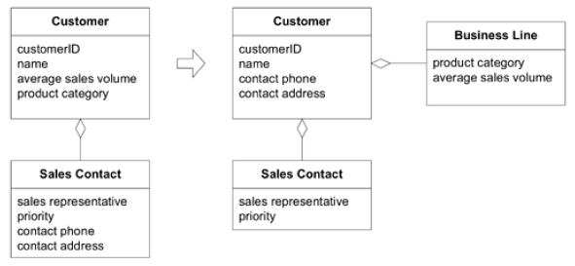
A Model expressed in software Entities
„An object primarily defined by its identity is called an Entity.”
Notes:
One of the most important fundamental concepts to understand is the definition of Entity in Domain -
Driven Design. According to Evans “ An object primarily defined by its identity is called an Entity. ”
Entities are very important in the domain model, and need to be designed carefully. Sometimes what
people think of as an entity in one system is not an entity in another system; for example, an address. In
some systems, an address may not have an identity at all; it may only represent attributes of a person or
company. In other systems, such as a cable television company or a utility company, the address could be
very important. In those systems, the address is important as an identity because the billing may be tied
directly to the address. In that case, the address would definitely be classified as an entity. In other
systems, such as an e - commerce web site, the address may only be used for determining where to send
an order, and the identity of the address may not really matter much, just the attributes of the address so
that the order can be fulfilled. In those types of cases, the address becomes what is called in Domain - Driven
Design a Value object.

Slide 11
A Model expressed in software Value Objects
„These are the objects that describe things.”
Notes:
Unlike Entity objects, Value objects have no identity. There is no need to track the object ’ s identity, and it
is very easy to create and discard. Most of the time, Value objects usually contain either just data or just
behavior. The ones that contain only data are also known as Data Transfer Objects (DTOs) (Fowler,
Patterns of Enterprise Application Architecture , 401). A very common scenario is for an Entity to contain
other Value objects. There are also times where Value objects can contain other Value objects, even other
Entity objects. Most of the time, as in the case of the address example used earlier, they are a group of
attributes that make up a conceptual whole but without an identity.
It is recommended that Value objects be immutable, that is, they are created with a constructor, with all
properties being read - only. To get a different value for the object, a new one must be created. A perfect
example of this is the System.String class. Value objects do not always have to be immutable, but the
main rule to follow is that if the object is going to be shared, then it needs to be immutable.
In distinguishing between Entity objects and Value objects, if the object does not have an identity that I
care about, then I classify it as a Value object.

Slide 12
A Model expressed in software Services
„A SERVICE is an operation offered as an interface that stands alone in the model, without encapsulating state, as ENTITIES and VALUE OBJECTS do.”
A good SERVICE has three characteristics.
1.The operation relates to a domain concept that is not a natural part of an ENTITY or VALUE OBJECT.
2. The interface is defined in terms of other elements of the domain model.
3. The operation is stateless.
Where are services located?
Application layer
Domain layer
Infrastructure layer
Notes:
Sometimes, when designing a domain model, you will have certain types of behavior that do not fit into
any one class. Trying to tack on the behavior to a class to which it really does not belong will only cloud
the domain model, but .NET, and all other object - oriented languages, requires the behavior to live in
some type of object, so it cannot be a separate function on its own (as you might find in JavaScript or
other scripting languages). The type of class that becomes the home for this behavior is known in
Domain - Driven Design as a Service.
A Service class has no internal state and can simply act as an interface implementation that provides
operations. This concept is very similar to web services. Services typically coordinate the work of one or
more domain objects, and present the coordination as a well - known operation. It is also important to
note that some services may live in the application layer, some may live in the domain layer, and others
may live in the infrastructure layer.
Application Layer Services
The services that live in the application layer typically coordinate the work of other services in other
layers. Consider an order fulfillment service. This service probably takes in an order message in the
format of XML data, calls a factory to transform the XML into an object, and then sends the object to
the domain layer for processing. After processing has been completed, the service may need to send out
a notification to a user, and it may delegate that to an infrastructure layer service.
Domain Layer Services
In keeping with the order fulfillment example, the domain layer service would be responsible for
interacting with the right Entity objects, Value objects, and other domain layer objects necessary to
process the order in the domain. Ultimately, the service would return some type of result from the
operation so that the calling service could take the necessary actions.
Infrastructure Layer Services
In the same order fulfillment scenario, the infrastructure layer service may need to do things like sending
the user an order confirmation email letting them know that their order is being processed. These types
of activities belong in the infrastructure layer.
Application Layer Services
The services that live in the application layer typically coordinate the work of other services in other
layers. Consider an order fulfillment service. This service probably takes in an order message in the
format of XML data, calls a factory to transform the XML into an object, and then sends the object to
the domain layer for processing. After processing has been completed, the service may need to send out
a notification to a user, and it may delegate that to an infrastructure layer service.
Domain Layer Services
In keeping with the order fulfillment example, the domain layer service would be responsible for
interacting with the right Entity objects, Value objects, and other domain layer objects necessary to
process the order in the domain. Ultimately, the service would return some type of result from the
operation so that the calling service could take the necessary actions.
Infrastructure Layer Services
In the same order fulfillment scenario, the infrastructure layer service may need to do things like sending
the user an order confirmation email letting them know that their order is being processed. These types
of activities belong in the infrastructure layer.

Slide 13
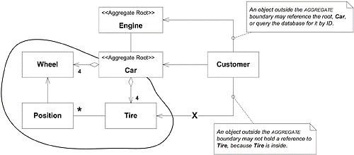
A Model expressed in software Aggregates
„An Aggregate is a term used to define object ownership and the boundaries between objects and their relationships.”
Notes:
In Domain - Driven Design speak, an Aggregate is a term used to define object ownership and the
boundaries between objects and their relationships. It is used to define a group of associated objects that
are to be treated as one unit in regard to data changes.
For example, an Order class and its associated
line items can be considered to be part of the same Order Aggregate, with the Order class being the root
of the Aggregate. That brings me to a very important rule, and that is each Aggregate can only have one
root object, and that object is an Entity object. The root of an Aggregate can hold references to the roots of
other Aggregates, and objects inside of an Aggregate can hold references to one another, but nothing
outside of the Aggregate boundary can access the objects inside of the Aggregate without going through
that Aggregate ’ s root object.
It is easier to understand this concept with an example. The example I always use is the canonical Order
Aggregate. An Order object is the root of its own Aggregate, and it contains objects such as Line Items
(which can contain Products) and Customers. To get to a Line Item object, I would have to go through
the Order Aggregate root object, the Order object. If I only wanted get some data about a Customer, and
not the Order, I might choose to start from the Customer Aggregate. I could move from the Order
Aggregate to the Customer Aggregate, since the Order Aggregate contains an instance of a Customer
object. On the other hand, I could get to a Customer ’ s Order by going through the Customer Aggregate
first, and then traversing the relationship between a Customer and his Orders. In this case, the
relationship is bidirectional, and I could choose to start from the Customer Aggregate or from the Order
Aggregate, depending on the use case. The key to remember is that both the Customer and the Order are
the roots of their own Aggregate, and can also hold references to other Aggregate roots. I could not go
directly from a Customer to a Line Item; I would first need to go to the Customer ’ s Order, and then
travel from there to the Line Item.
Defining the Aggregates in a domain model is one of the hardest activities to get right in Domain - Driven
Design, and this is where you really need the help of an expert in the business domain that you are
dealing with to determine the right boundaries and associations. It is also an area that I end up
refactoring a lot as I begin to understand more about the business model of an application.

Slide 14
A Model expressed in software Bounded Context
Notes:
Cells can exist because their membranes define what is in and out and determine what
can pass.
Multiple models coexist on big projects, and this works fine in many cases. Different models apply
in different contexts. For example, you may have to integrate your new software with an external
system over which your team has no control. A situation like this is probably clear to everyone as
a distinct context where the model under development doesn't apply, but other situations can be
more vague and confusing. In the story that opened this chapter, two teams were working on
different functionality for the same new system. Were they working on the same model? Their
intention was to share at least part of what they did, but there was no demarcation to tell them
what they did or did not share. And they had no process in place to hold a shared model together
or quickly detect divergences. They realized they had diverged only after their system's behavior
suddenly became unpredictable.
Even a single team can end up with multiple models. Communication can lapse, leading to subtly
conflicting interpretations of the model. Older code often reflects an earlier conception of the
model that is subtly different from the current model.
Everyone is aware that the data format of another system is different and calls for a data
conversion, but this is only the mechanical dimension of the problem. More fundamental is the
difference in the models implicit in the two systems. When the discrepancy is not with an external
system, but within the same code base, it is even less likely to be recognized. Yet this happens on
all large team projects.
Multiple models are in play on any large project. Yet when code based on distinct
models is combined, software becomes buggy, unreliable, and difficult to understand.
Communication among team members becomes confused. It is often unclear in what
context a model should not be applied.
Failure to keep things straight is ultimately revealed when the running code doesn't work right, but
the problem starts in the way teams are organized and the way people interact. Therefore, to
clarify the context of a model, we have to look at both the project and its end products (code,
database schemas, and so on).
A model applies in a context. The context may be a certain part of the code, or the work of a
particular team. For a model invented in a brainstorming session, the context could be limited to
that particular conversation. The context of a model used in an example in this book is that
particular example section and any later discussion of it. The model context is whatever set of
conditions must apply in order to be able to say that the terms in a model have a specific meaning.
To begin to solve the problems of multiple models, we need to define explicitly the scope of a
particular model as a bounded part of a software system within which a single model will apply and
will be kept as unified as possible. This definition has to be reconciled with the team organization.
Therefore:
Explicitly define the context within which a model applies. Explicitly set boundaries in
terms of team organization, usage within specific parts of the application, and physical
manifestations such as code bases and database schemas. Keep the model strictly
consistent within these bounds, but don't be distracted or confused by issues outside.
A BOUNDED CONTEXT delimits the applicability of a particular model so that team members have a
clear and shared understanding of what has to be consistent and how it relates to other CONTEXTS.
Within that CONTEXT, work to keep the model logically unified, but do not worry about applicability
outside those bounds. In other CONTEXTS, other models apply, with differences in terminology, in
concepts and rules, and in dialects of the UBIQUITOUS LANGUAGE. By drawing an explicit boundary,
you can keep the model pure, and therefore potent, where it is applicable. At the same time, you
avoid confusion when shifting your attention to other CONTEXTS. Integration across the boundaries
necessarily will involve some translation, which you can analyze explicitly.
BOUNDED CONTEXTS Are Not MODULES
The issues are confused sometimes, but these are different patterns with different
motivations. True, when two sets of objects are recognized as making up different
models, they are almost always placed in separate MODULES. Doing so does provide
different name spaces (essential for different CONTEXTS) and some demarcation.
But MODULES also organize the elements within one model; they don't necessarily
communicate an intention to separate CONTEXTS. The separate name spaces that
MODULES create within a BOUNDED CONTEXT actually make it harder to spot accidental
model fragmentation.
Example
Booking Context
A shipping company has an internal project to develop a new application for booking cargo. This
application is to be driven by an object model. What is the BOUNDED CONTEXT within which this
model applies? To answer this question, we have to look at what is happening on the project. Keep
in mind, this is a look at the project as it is, not as it ideally should be.
One project team is working on the booking application itself. They are not expected to modify the
model objects, but the application they are building has to display and manipulate those objects.
This team is a consumer of the model. The model is valid within the application (its primary
consumer), and therefore the booking application is in bounds.
The completed bookings have to be passed to the legacy cargotracking system. A decision was
made up front that the new model would depart from that of the legacy, so the legacy
cargotracking system is outside the boundary. Necessary translation between the new model and
the legacy is to be the responsibility of the legacy maintenance team. The translation mechanism
is not driven by the model. It is not in the BOUNDED CONTEXT. (It is part of the boundary itself,
which will be discussed in CONTEXT MAP.) It is good that translation is out of CONTEXT (not based on
the model). It would be unrealistic to ask the legacy team to make any real use of the model
because their primary work is out of CONTEXT.
The team responsible for the model deals with the whole life cycle of each object, including
persistence. Because this team has control of the database schema, they've been deliberately
keeping the object-relational mapping straightforward. In other words, the schema is being driven
by the model and therefore is in bounds.
Yet another team is working on a model and application for scheduling the voyages of the cargo
ships. The scheduling and booking teams were initiated together, and both teams had intended to
produce a single, unified system. The two teams have casually coordinated with each other, and
they occasionally share objects, but they are not systematic about it. They are not working in the
same BOUNDED CONTEXT. This is a risk, because they do not think of themselves as working on
separate models. To the extent they integrate, there will be problems unless they put in place
processes to manage the situation. (The SHARED KERNEL, discussed later in this chapter, might be a
good choice.) The first step, though, is to recognize the situation as it is. They are not in the same
CONTEXT and should stop trying to share code until some changes are made.
This BOUNDED CONTEXT is made up of all those aspects of the system that are driven by this
particular model: the model objects, the database schema that persists the model objects, and the
booking application. Two teams work primarily in this CONTEXT: the modeling team and the
application team. Information has to be exchanged with the legacy tracking system, and the
legacy team has primary responsibility for the translation at this boundary, with cooperation from
the modeling team. There is no clearly defined relationship between the booking model and the
voyage schedule model, and defining that relationship should be one of those teams' first actions.
In the meantime, they should be very careful about sharing code or data.
So, what has been gained by defining this BOUNDED CONTEXT? For the teams working in CONTEXT:
clarity. Those two teams know they must stay consistent with one model. They make design
decisions in that knowledge and watch for fractures. For the teams outside: freedom. They don't
have to walk in the gray zone, not using the same model, yet somehow feeling they should. But
the most concrete gain in this particular case is probably realizing the risk of the informal sharing
between the booking model team and the voyage schedule team. To avoid problems, they really
need to decide on the cost/benefit trade-offs of sharing and put in processes to make it work. This
won't happen unless everyone understands where the bounds of the model contexts are.
Of course, boundaries are special places. The relationships between a BOUNDED CONTEXT and its
neighbors require care and attention. The CONTEXT MAP charts the territory, giving the big picture
of the CONTEXTS and their connections, while several patterns define the nature of the various
relationships between CONTEXTS. And a process of CONTINUOUS INTEGRATION preserves unity of the
model within a BOUNDED CONTEXT.
But before proceeding to all that, what does it look like when unification of a model is breaking
down? How do you recognize conceptual splinters?
Recognizing Splinters Within a BOUNDED CONTEXT
Many symptoms may indicate unrecognized model differences. Some of the most obvious are
when coded interfaces don't match up. More subtly, unexpected behavior is a likely sign. The
CONTINUOUS INTEGRATION process with automated tests can help catch these kinds of problems. But
the early warning is usually a confusion of language.
Combining elements of distinct models causes two categories of problems: duplicate concepts and
false cognates. Duplication of concepts means that there are two model elements (and attendant
implementations) that actually represent the same concept. Every time this information changes,
it has to be updated in two places with conversions. Every time new knowledge leads to a change
in one of the objects, the other has to be reanalyzed and changed too. Except the reanalysis
doesn't happen in reality, so the result is two versions of the same concept that follow different
rules and even have different data. On top of that, the team members must learn not one but two
ways of doing the same thing, along with all the ways they are being synchronized.
False cognates may be slightly less common, but more insidiously harmful. This is the case when
two people who are using the same term (or implemented object) think they are talking about the
same thing, but really are not. The example in the beginning of this chapter (two different
business activities both called Charge) is typical, but conflicts can be even subtler when the two
definitions are actually related to the same aspect in the domain, but have been conceptualized in
slightly different ways. False cognates lead to development teams that step on each other's code,
databases that have weird contradictions, and confusion in communication within the team. The
term false cognate is ordinarily applied to natural languages. For example, English speakers
learning Spanish often misuse the word embarazada. This word does not mean "embarrassed"; it
means "pregnant." Oops.
When you detect these problems, your team will have to make a decision. You may want to pull
the model back together and refine the processes to prevent fragmentation. Or the fragmentation
may be a result of groups who want to pull the model in different directions for good reasons, and
you may decide to let them develop independently. Dealing with these issues is the subject of the
remaining patterns in this chapter.

Slide 15
A Model expressed in software Repositories
„represents all objects of a certain type as a conceptual
set (usually emulated)”
Notes:
According to Eric Evans, a repository “ represents all objects of a certain type as a conceptual set (usually
emulated) ” (Evans, Domain - Driven Design: Tackling Complexity in the Heart of Software , 151). He also goes
on to say that for every object that is an Aggregate, create a repository for the object and give it the look
and feel of an in - memory collection of objects of that particular type. The access to the repository must
be through a well - known interface. The main point of repositories is to keep the developer focused on
the domain model logic, and hide the plumbing of data access behind well - known repository interfaces.
This concept is also known as persistence ignorance , meaning that the domain model is ignorant of how its
data is saved or retrieved from its underlying data store or stores.

Slide 16
A Model expressed in software Factories
There are two types of Factories:
building the root Entity of an Aggregate (usually from some type of resultset data)
building Value objects (usually from some type of configuration data)
Notes:
As the Entities and their associated Aggregates start to grow in the domain layer, it becomes increasingly
more difficult to build up objects consistently just using constructors. Lots of times there is intimate
knowledge needed to construct an Aggregate and all of its relationships, constraints, rules, and the like.
Instead of making the Entity objects themselves responsible for this creation, it is better to have a Factory
that knows how to build these types of objects, and thus avoid clouding up the code of an Entity object.
In Domain - Driven Design, there are two types of Factories, those for building the root Entity of an
Aggregate (usually from some type of resultset data) and those for building Value objects (usually from
some type of configuration data).

Slide 17
Modeling example Background and functional requirements
A company provides IT Body Leasing. They have some Employees, and also a lot of Freelancers as Subcontractors. Currently, they use Excel sheets to manage their Customers, Freelancers, Timesheets and so on. The Excel solution does not scale well. It is not multi-user ready and also does not provide security and audit logs. So they decided to build a new web based solution.
Other requirements:
- A searchable catalog of Freelancer must be provided
- The new solution must allow do store the different Communication Channels available to contact a Freelancer
- A searchable catalog of Projects must be provided
- A searchable catalog of Customers must be provided
- The Timesheets for the Freelancers under contract must be maintained

Slide 18
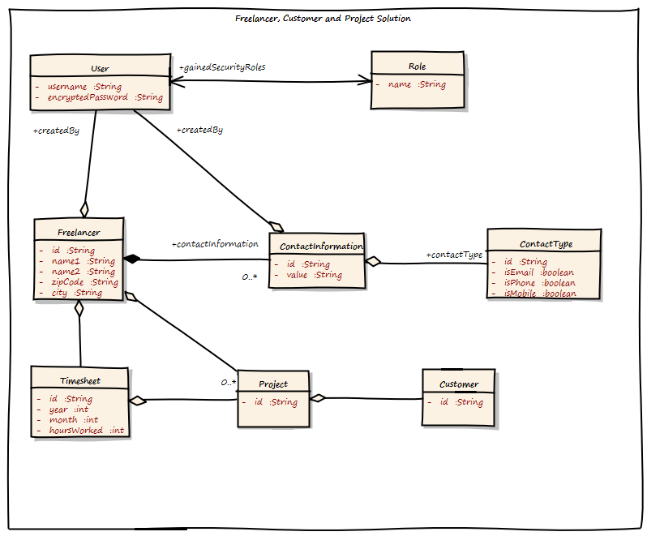
Modeling example The big picture
- Very big object graph
- Association between User and Role bi-directional
- ContractType has some boolean flags
- The Freelancer class holds a list of Projects
- What does ContactInformation mean?
Notes:
It is a very big object graph. If they do not use Hibernate/ JPA lazy loading here, it will pretty sure run out of memory under heavy load
Why is the association between User and Role bi-directional?`
The ContactType has some boolean flags to show what type is it, email, phone, mobile
The Freelancer class holds a list of Projects. This also means that Projects cannot be added without modifying the Freelancer object. This can cause transaction failure under heavy load, as possibly multiple users are adding Projects for the same Customer.
What does ContactInformation mean? The requirements stated “Communication Channel”. Is it the same?

Slide 19
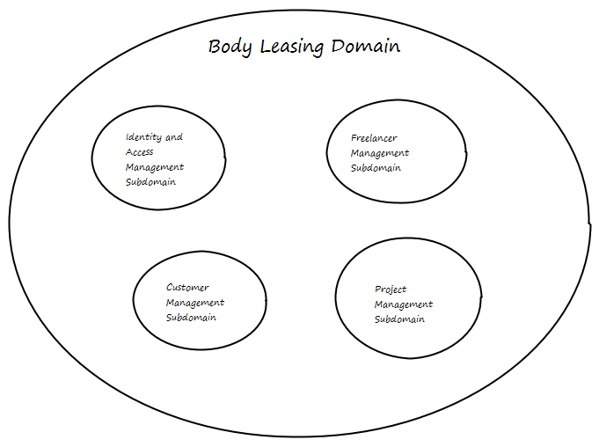
Modeling example Indentifying domains
- Identity and Access Management Subdomain
- Freelancer Management Subdomain
- Customer Management Subdomain
- Project Management Subdomain
The separated Domain can easily be visualized. In DDD terms this is called a Context Map, and it is the starting point for any further modeling.
Notes:
We can split the big problem into smaller ones. This can help us to design a better solution. The separated Domain can easily be visualized. In DDD terms this is called a Context Map, and it is the starting point for any further modeling.

Slide 21
Iteration cycle diagram
Model The Domain
Refine the Model
Design / Architecture
DDD,
Design Patterns
Agile Project Management
Implementation
Development / Refactoring
SCRUM, XP
Unit / Integration testing
Code Generation
Continuous Integration
TDD, Automated Developer Tests
Notes:
From a project management stand-point, a real-world DDD implementation project comprises the same phases as any other software development project.
These phases include:
- Model the domain
- Design
- Development
- Unit and Integration Testing
- Refine and refactor the domain model based on the design and development (Continuous Integration (CI) of model concepts).
Repeat the above steps using the updated domain model (CI of domain implementation).
An agile software development methodology is a great fit here because agile methodologies focus on the delivery of business value just like DDD focuses on the alignment of software system with business model. Also, with the iterative nature of DDD, agile methodologies such as SCRUM or DSDM are better frameworks to manage the project. Using SCRUM (for project management) and XP (for software development purposes) methodologies is a good combination for managing a DDD implementation project.
Domain driven design effort begins where domain modeling ends. Most people recommends the following steps on how to go about implementing a domain object model. They emphasizes on putting more focus on domain objects than services in the domain model.
1. Start with domain entities and domain logic (without service layer initially).
2. Add services only where the logic doesn't belong in any domain entity or value object.
3. Use Ubiquitous Language, Contracts design, Automated Tests, Continuous Integration and Refactoring to make the implementation as closely aligned as possible with the domain model.
Lets focus a little on design. From the design and implementation stand-point, a typical DDD framework should support the following features:
1. It should be a POJO (or POCO if your company is a .NET shop) based framework.
2. It should support the design and implementation of a business domain model using the DDD concepts.
3. It should support concepts like Dependency Injection (DI) and Aspect Oriented Programming (AOP) out of the box, Integration with unit testing frameworks such as JUnit, NUnit, Tests integrated with VS, etc.
4. Good integration with other frameworks like Hibernate, Nhibernate, etc.

Slide 22
Unit tests and Refactoring
Notes:
Refactoring
Refactoring is changing or restructuring the application code without changing the functionality or behavior of the application. Refactoring can be either design or code related. Design refactoring is done to continually refine the model and refactor the code to improve the domain model.
Refactoring plays an important role in the DDD project due to its iterative and evolutionary nature of domain modeling. One way to integrate refactoring tasks into the project is to add it in each iteration of the project before calling the iteration done. Ideally, refactoring should be done before and after every development task.
Refactoring should be done with strict discipline. Use the combination of refactoring, CI, and unit testing to make sure the code changes didn't break any functionality and at the same time the changes did help with the intended code or performance improvements.
Automated tests play a vital role in refactoring the application code. Without good automated developer tests and Test Driven Development (TDD) practices, refactoring can be counter-productive since there will be no automated way to verify that the design and code changes made as part of refactoring effort didn't change the behavior or break the functionality.
Tools like Eclipse help in implementing the domain model in an iterative way with refactoring as part of the development effort. Eclipse has features like extracting or moving a method to a different class or pushing down a method to a subclass. There are also several code analysis plugins for Eclipse that can help in managing the code dependencies and identifying the DDD anti-patterns. I rely on plugins like JDepend, Classycle, and Metrics when I do the design and code review of projects, to assess the quality of domain and other modules in the application.
Chris Richardson talked about applying code refactoring to transform a procedural design into an OO design using refactoring features provided by Eclipse.
Unit Testing/Continuous Integration
One of the goals we talked about earlier is that the domain classes should be unit testable (during the initial development as well as later when refactoring the existing code) without too many dependencies on the container or other infrastructure code. TDD approach helps the team in finding any design problems early in the project as well as verifying that the code is in alignment with domain model. DDD is ideal for Test-First development because the state and behavior are contained in domain classes and it should be easy to test them in isolation. It is important to test the state and behavior of domain model and not focus too much on the implementation details of data access or persistence.
Unit testing frameworks like JUnit or TestNG are great tools to implement and manage the domain model. Other testing frameworks like DBUnit and Unitils can also be used to test domain layer especially to inject test data into DAO classes. This will minimize writing extra code for populating test data in unit test classes.
Mock objects also help in testing the domain objects in isolation. But it's important to not go crazy with using mock objects in the domain layer. If there are other easy ways to test domain classes, you should use those options instead of using mock objects. For example, if you can test an Entity class using a real DAO class in the back-end (instead of a mock DAO implementation) with an in-memory HSQL database instead of the real database; it will make the domain layer unit tests run quicker which is the main idea behind using mock objects any way. This way, you will be testing the collaboration (interaction) between domain objects as well as the state (data) exchanged between them. With mock objects, we will only be testing the interaction between the domain objects.
All unit and integration tests created during the development phase (with or without using TDD practices) will become part of the automated test suite once the development tasks are done. These tests should be maintained and executed frequently in the local and higher development environments to find if the new code changes introduced any bugs into domain classes.
Eric Evans covers CI in his book saying that CI effort should always be applied within a Bounded Context and it should include the synchronization of people as well as code. CI tools likeCruiseControl and Hudson can be used to set up an automatic build and test environment to run the application build script (created using a build tool such as Ant or Maven) to checkout the code from a SCM repository (like CVS, Subversion etc), compile the domain classes (as well as the other classes in the application) and if there are no build errors, then automatically run all the tests (unit and integration). CI tools can also be setup to notify the project teams (via e-mail or RSS feeds) if there are any build or test errors.

Slide 23
Benefits of DDD
Notes:
A domain model offers several benefits some of which are:
It helps the team create a common model, between the business and IT stakeholders in the company, that the team can use to communicate about the business requirements, data entities, and process models.
The model is modular, extensible and easy to maintain as the design reflects the business model.
It improves the reusability and testability of the business domain objects.
One principle behind DDD is to bridge the gap between domain experts and developers by using the same language to create the same understanding. Another principle is to reduce complexity by applying object oriented design and design patters to avoid reinventing the wheel.

Slide 24
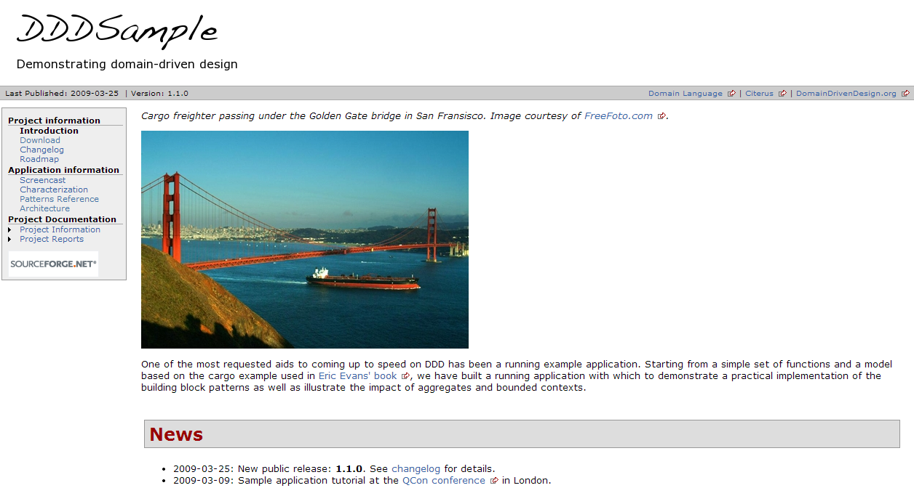
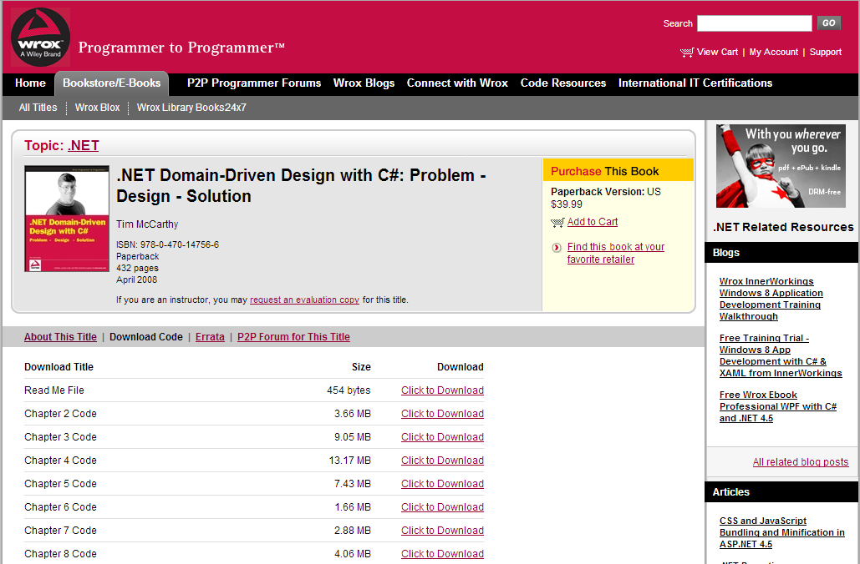
Example in VS
http://dddsample.sourceforge.net/
http://www.wrox.com/WileyCDA/WroxTitle/-NET-Domain-Driven-Design-with-C-Problem-Design-Solution.productCd-0470147563,descCd-DOWNLOAD.html

Slide 25
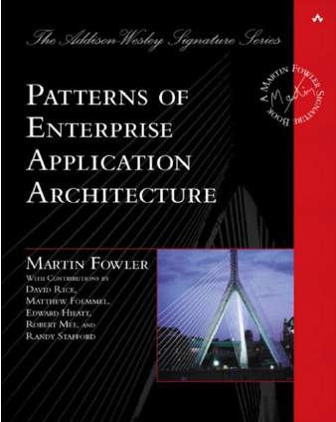
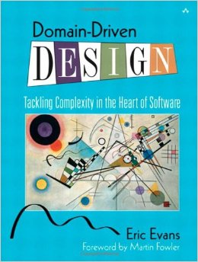
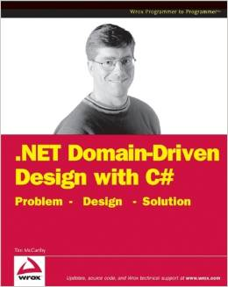
References
Notes:
Conclusion
DDD is a powerful concept that will change the way modelers, architects, developers, and testers will look at the software once the team is trained in DDD and start to apply "domain first and infrastructure second" philosophy. As different stakeholders (from IT and business units) with different backgrounds and areas of expertise are involved in the domain modeling, design and implementation effort, to quote Eric Evans, "it's important not to blur the lines between the philosophy of design (DDD) and the technical tool box that helps us fulfill it (OOP, DI, and AOP)".
Advancing Frontiers
This section covers some of the emerging approaches that impact the DDD design and development. Some of these concepts are still evolving and it will be interesting to see how they will affect DDD.
Architecture rules and Design by Contract enforcement plays an important role in the governance and policy enforcement of domain model standards and implementation best practices. Ramnivas talked about using the Aspects to enforce the rule of creating a Repository object only through Factories; this is an easy to violate design rule in domain layer.
Domain Specific Languages (DSL) and Business Natural Languages (BNL) are gaining more attention in the recent years. One can use these languages to represent business logic in the domain classes. BNL's are powerful in the sense that they can be used to capture business specifications, documenting the business rules, and as executable code as well. They can also be used to create test cases to verify the system works as expected.
Behavior Driven Development (BDD) is another interesting concept that has been discussed lately. BDD helps focus development on the delivery of prioritized, verifiable business value by providing a common vocabulary (Ubiquitous Language) that spans the divide between Business and Technology. By using terminology focused on the behavioral aspects of the system rather than testing, BDD attempts to help direct developers towards a focus on the real value to be found in TDD at its most successful. If practiced correctly, BDD can be a great complement to DDD where the development of domain objects is positively influenced by BDD concepts; after all domain objects are supposed to encapsulate state and behavior.
Event Driven Architecture (EDA) is another area that could play a role in domain driven design. For example, an event model to notify of any state change in the domain object instance would help in handling the post-event processing tasks that need to be triggered when the state of a domain object changes. EDA helps in encapsulating the event based logic from getting embedded in core domain logic. Martin Fowler documented about Domain Event design pattern.

Slide 26
References
http://dddsample.sourceforge.net/
http://www.wrox.com/WileyCDA/WroxTitle/-NET-Domain-Driven-Design-with-C-Problem-Design-Solution.productCd-0470147563,descCd-DOWNLOAD.html
http://www.mirkosertic.de/doku.php/architecturedesign/dddexample
http://www.infoq.com/presentations/strategic-design-evans
http://www.infoq.com/presentations/model-to-work-evans
http://msdn.microsoft.com/pl-pl/magazine/dn342868(en-us).aspx
http://www.infoq.com/articles/ddd-in-practice

Slide 27
Questions?
Thank you!

Slide 28
Design patterns working group
Main activities:
- Review of current architectures and frameworks in EDIT
- Patterns analyze and learning on real examples
To be considered:
- Collaboration with other working groups
- Recommendations
- Audits
To be considered in future:
- Ready to use components
- Credit Suisse Application Design Framework
Goals:
- Broaden knowledge in area of design patterns
- Increase quality of delivered products
- Improve communication with stakeholders
In higher perspective:
- Increase maturity of Polish site
-
-

Slide 29
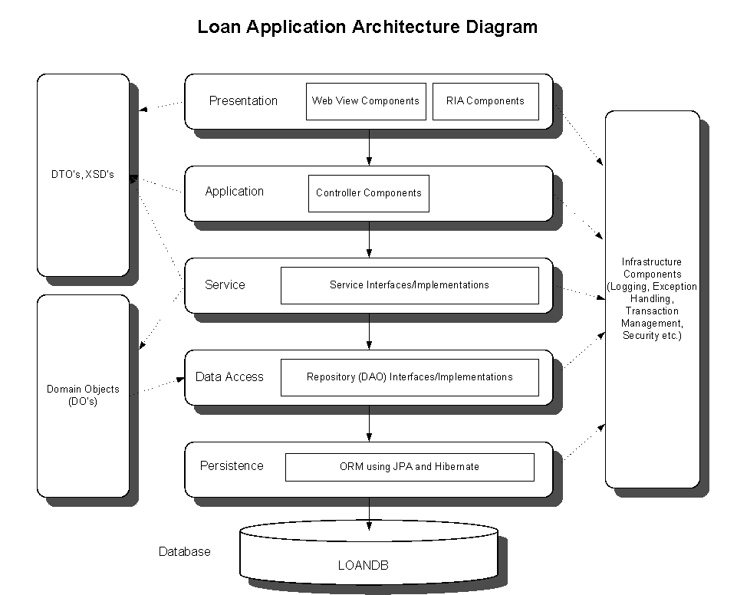
Application architecture
Notes:
http://www.mirkosertic.de/doku.php/architecturedesign/dddexample
Financial analysts crunch numbers. Effective domain modelers are knowledge crunchers. They take a torrent of information and probe
for the relevant trickle. They try one organizing idea after another, searching for the simple view
that makes sense of the mass.
Rich domain model
The domain model should focus on a specific business operational domain. It should align with the business model, strategies and business processes.
It should be isolated from other domains in the business as well as other layers in the application architecture.
It should be reusable to avoid any duplicate models and implementations of the same core business domain elements.
The model should be designed loosely coupled with other layers in the application, meaning no dependencies on the layers on either side of domain layer (i.e. database and facade layers).
It should be an abstract and cleanly separated layer enabling easier maintenance, testing, and versioning. The domain classes should be unit testable outside the container (and from inside the IDE).
It should be designed using a POJO programming model without any technology or framework dependencies (I always tell the project teams I work with in my company, that the technology we use for software development is Java).
The domain model should be independent of persistence implementation details (although the technology does place some constraints on the model).
It should have minimum dependencies on any infrastructure frameworks because it will outlive these frameworks and we don't want any tight coupling on any external framework.
DDD is not a technology or methodology. DDD provides a structure of practices and terminology for making design deisions that focus and accelerate software projects complicated domains.
A domain modeling project typically includes the following steps:
Model and document business processes first.
Select a candidate business process and work with the business domain experts to document it using the Ubiquitous Language.
Identify all the services that are required for the candidate business process. These services can be atomic (single step) or orchestrated (multi-step with or without work-flow) in nature. They can also be business (e.g. Underwriting or Funding) or infrastructure (e.g. E-mail or Job Scheduling).
Identify and document the state and behavior of the objects used by services identified in the previous step.
When Modeling the Domain, Forget About Persistence
Modeling the domain is all about focusing on the tasks of the business. When designing types and their properties and behaviors, I’m sorely tempted to think about how a relationship will work out in the database and how my object relational mapping (ORM) framework of choice—Entity Framework—will treat the properties, relationships and inheritance hierarchies that I’m building. Unless you’re building software for a company whose business is data storage and retrieval—something like Dropbox—data persistence only plays a supporting role in your application.
---------------------
Every Deployment Unit contains the following parts:
A Domain Layer
An Infrastructure Layer
and an Application Layer
The Domain Layer contains the infrastructure independent domain logic as we modeled before in this example. The Infrastructure Layer provides the technology dependent artifacts, like the Hibernate based FreelancerRepository implementation. The Application Layer acts as a gateway to business logic with integrated transaction control.
Domain Layer
The Domain Layer contains the real business logic, but does not contain any infrastructure specific code. The infrastructure specific implementation is provided by the Infrastructure Layer. The Domain Model should be designed as described by the CQS(Command-Query-Separation) principle. There can be query methods which do just return data without affecting state, and there are command methods, which affect state but do not return anything.
Application Layer
The Application Layer takes commands from the User Interface Layer and translates these commands to use case invocations on the domain layer. The Application Layer also provides transaction control for business operations. The application layer is responsible to translate Aggregate data into the client specific presentation model by a Mediator or Data Transformer pattern.
Infrastructure Layer
The Infrastructure Layer provides the infrastructure dependent parts for all other layers, like a Hibernate or JPA backed implementation. Aggregate data can be stored in an RDMBS like Oracle or MySQL, or it can be stored as XML/JSON or even Google ProtocolBuffers serialized objects in a key-value or document based NoSQL engine. This is up to you, as long the storage provides transaction control and guarantees consistency. Infrastructure can be best described as “Everything around the domain model”, so databases, file system resources or even WebService consumers if we interact with other systems.
---------------------
Let's look at the application and domain layers in more detail. The Application layer:
is responsible for the navigation between the UI screens in the application as well as the interaction with the application layers of other systems.
can also perform the basic (non-business related) validation on the user input data before transmitting it to the other (lower) layers of the application.
doesn't contain any business or domain related logic or data access logic.
doesn't have any state reflecting a business use case but it can manage the state of the user session or the progress of a task.
The domain layer:
is responsible for the concepts of business domain, information about the business use case and the business rules. Domain objects encapsulate the state and behavior of business entities. Examples of business entities in a loan processing application are Mortgage, Property, and Borrower.
can also manage the state (session) of a business use case if the use case spans multiple user requests (e.g. loan registration process which consists of multiple steps: user entering the loan details, system returning the products and rates based on the loan parameters, user selecting a specific product/rate combination, and finally the system locking the loan for that rate).
contains service objects that only have a defined operational behavior which is not part of any domain object. Services encapsulate behavior of the business domain that doesn't fit in the domain objects themselves.
is the heart of the business application and should be well isolated from the other layers of the application. Also, it should not be dependent on the application frameworks used in the other layers (JSP/JSF, Struts, EJB, Hibernate, XMLBeans and so-on).
Figure 2 below shows the different architecture layers used in the application and how they relate to DDD.
Figure 2. Layered Application Architecture diagram (Click on the screen shot to open a full-size view.)
Following design aspects are considered as the main ingredients of the current DDD implementation recipe:
Object Oriented Programming (OOP)
Dependency Injection (DI)
Aspect Oriented Programming (AOP)
OOP is the most important element in the domain implementation. Domain objects should be designed using Plain Java Classes and Interfaces by taking advantage of OOP concepts like inheritance, encapsulation, and polymorphism. Most of the domain elements are true objects with both State (attributes) and Behavior (methods or operations that act on the state). They also correspond to real world concepts and can fit right in with OOP concepts. Entities and Value Objects in DDD are classic examples of OOP concepts since they have both state and behavior.
In a typical Unit of Work (UOW), domain objects need to collaborate with other objects whether they are Services, Repositories or Factories. Domain objects also need to manage other concerns such as domain state change tracking, auditing, caching, transaction management (including transaction retry) which are cross-cutting in nature. These are reusable non-domain related concerns that typically tend to be scattered and duplicated all over the code including the domain layer. Embedding this logic in the domain objects leads to tangling and cluttering of the domain layer with non-domain related code.
When it comes to managing the code dependencies without tight-coupling between objects and isolating cross-cutting concerns, OOP alone cannot provide an elegant design solution for domain driven design and development. This is where design concepts like DI and AOP can be used to complement OOP to minimize tight coupling, enhance modularity and better manage the cross-cutting concerns.
Dependency Injection
DI is a great way to move the configuration and dependency code out of the domain objects. Also, the design dependency of domain classes on Data Access Object (DAO) classes and service classes on domain classes makes DI a "must have" in DDD implementation. DI facilitates a cleaner and loosely coupled design by injecting the other objects such as Repositories and Services into Domain Objects.
In the sample application, the service object (FundingServiceImpl) uses DI to inject the Entity objects (Loan, Borrower and FundingRequest). Also, Entities reference Repositories via DI. Similarly, other Java EE resources like DataSource, Hibernate Session Factory and Transaction Manager are injected into Service and Repository objects.
Aspect Oriented Programming
AOP helps in an even better design (i.e. less cluttering in the domain model) by removing the cross-cutting concerns code like auditing, domain state change tracking etc from the domain objects. It can be used to inject collaborating objects and services into domain objects especially the objects that are not instantiated by the container (such as the persistence objects). Other aspects in the domain layer that could use AOP are caching, transaction management and role based security (authorization).
Loan processing application uses custom Aspects to introduce data caching into the Service objects. Loan product and interest rate information is loaded from the database table once (the first this information is requested by the client) and is then stored in an object cache (JBossCache) for subsequent product and rate lookups. Product and rate data is frequently accessed but it's not updated that regularly, so it's a good candidate for caching the data instead of hitting the back-end database every time.
The role of DI and AOP concepts in DDD was the main topic in a recent discussion thread. The discussion was based on a presentation by Ramnivas Laddad where he made the assertion thatDDD cannot be implemented without help of AOP and DI. In the presentation, Ramnivas talked about the concept of "fine grained DI" using AOP to make domain objects regain smart behavior. He mentioned that domain objects need access to other fine grained objects to provide rich behavior and a solution to this is to inject Services, Factories, or Repositories into Domain Objects (by using Aspects to inject dependency at constructor or setter invocation time).
Chris Richardson also discussed about using DI, objects, and Aspects to improve the application design by reducing coupling and increasing modularity. Chris talked about "Big Fat Service" anti-pattern which is the result of coupling, tangling and scattering of the application code and how to avoid it using DI and AOP concepts.

Slide 30
Layered/Tiered architectures
1 Layer
2 Layers
3 Layers
N Layers
Presentation
Presentation
Presentation
Infrastructure
Presentation
Infrastructure
Business Logic
Business Logic
Business Logic
...
Data Access Logic
Data Access Logic
Data Access Logic
...
Data Access Logic
Notes:
1 Layer
2 Layer
3 Layer
Not investing in a domain model and development effort leads to an application architecture with a "Fat Service Layer" and an "Anemic Domain Model" where facade classes (usually Stateless Session Beans) start accumulating more and more business logic and domain objects become mere data carriers with getters and setters. This approach also leads to domain specific business logic and rules being scattered (and duplicated in some cases) in several different facade classes.
Anemic domain models, in most cases, are not cost-effective; they don't give the company a competitive advantage over other companies because implementing business requirement changes in this architecture take too long to develop and deploy to production environment.

